Slide 1





India's biggest online grocery platform.
BIGBASKET
“INDIA’S LAST MINUTE APP”

Slide 2
sql project on
bigbasket dataset

Slide 3

INTRODUCTION:
This project analyzes a dataset of products from BigBasket, India's largest online grocery platform. The goal is to extract insights about product pricing, brand discounts, ratings, and category-wise distribution using SQL queries.

Slide 4
OBJECTIVES:
1
UNDERSTAND PRODUCT DISTRIBUTION
4
WINDOW FUNCTIONS
2
DATA CLEANING / PREPROCESSING
5
ANALYTICAL QUERIES
3
CTES (COMMON TABLE EXPRESSIONS)
🛠 Tools Used:
SQL, MySQL, vs code (for visualizations)

Slide 5
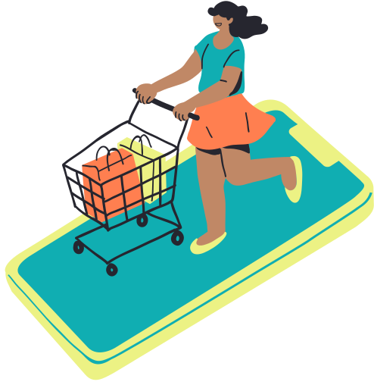




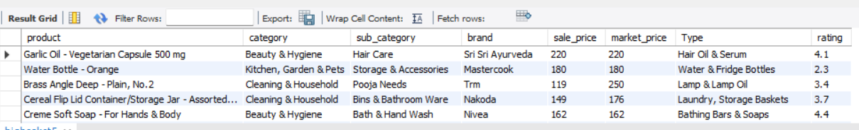
BIGBASKET TABLE VIEW:

Slide 6


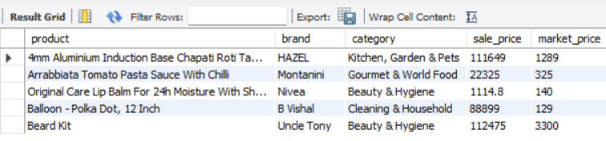
PRODUCTS WHERE SALE_PRICE > MARKET_PRICE (PRICING ANOMALY).

Slide 7

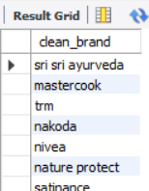
STANDARDIZE BRAND NAMES (REMOVE SPACES, LOWERCASE).

Slide 8
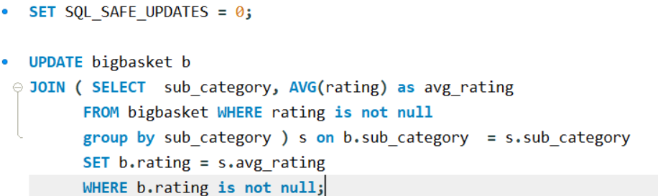
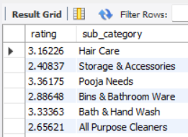
REPLACE MISSING RATINGS WITH SUB-CATEGORY AVERAGE.

Slide 9
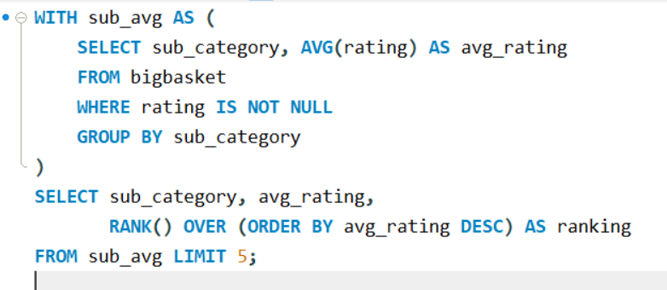
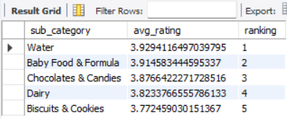
RANK SUB-CATEGORIES BY AVERAGE RATING AND RETURN TOP 5.

Slide 10


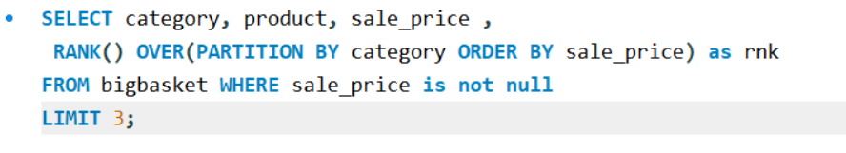
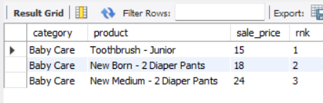
TOP 3 MOST EXPENSIVE PRODUCTS IN EACH CATEGORY.

Slide 11
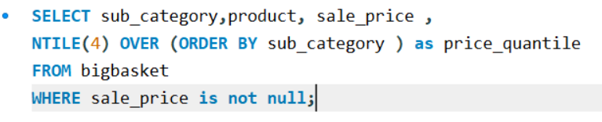
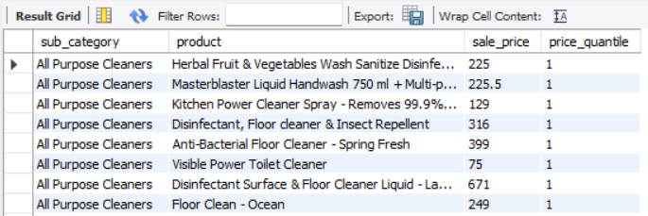
DIVIDE PRODUCTS INTO PRICE QUARTILES.

Slide 12
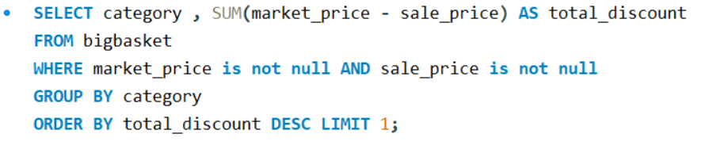


CATEGORY WHERE DISCOUNTS CONTRIBUTE THE MOST.

Slide 13
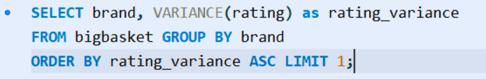
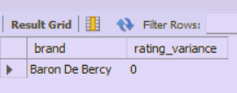
BRAND WITH THE HIGHEST RATING CONSISTENCY (LOWEST VARIANCE).

Slide 14
CONCLUSION OF BIGBASKET PRODUCT ANALYSIS
PRICING ANOMALY:
PRODUCTS WHERE SALE_PRICE IS HIGHER THAN MARKET_PRICE INDICATE POSSIBLE DATA OR PRICING ERRORS.
PRICE QUARTILE SEGMENTATION :
PRODUCTS WERE DIVIDED INTO FOUR QUARTILES FOR PRICE DISTRIBUTION ANALYSIS.
BRAND STANDARDIZATION:
BRAND NAMES WERE STANDARDIZED BY TRIMMING SPACES AND CONVERTING TO LOWERCASE.
CATEGORY WITH MAXIMUM DISCOUNTS →
THE CATEGORY WITH THE HIGHEST TOTAL DISCOUNT VALUE WAS IDENTIFIED.
MISSING RATINGS IMPUTATION:
MISSING RATINGS WERE REPLACED WITH SUB-CATEGORY AVERAGES FOR CONSISTENCY.
RATING CONSISTENCY BY BRAND →
THE BRAND WITH THE LOWEST VARIANCE IN RATINGS WAS FOUND, INDICATING HIGHEST CONSISTENCY.
TOP-RATED SUB-CATEGORIES :
THE TOP 5 SUB-CATEGORIES WITH THE HIGHEST AVERAGE RATINGS WERE IDENTIFIED.
MOST EXPENSIVE PRODUCTS :
THE TOP 3 MOST EXPENSIVE PRODUCTS IN EACH CATEGORY WERE RETRIEVED

Slide 15

THANKS FOR WATCHING

